Slide 1
Методическая разработка: «Урок-обобщение, подготовка к контрольной работе в 3 классе по теме: «Мир вокруг меня» УМК Forward Подготовила: учитель английского языка Базанова Е.А.

Slide 2
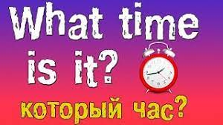

Slide 3
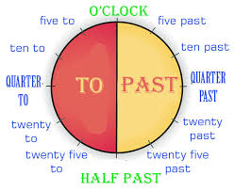

Slide 5
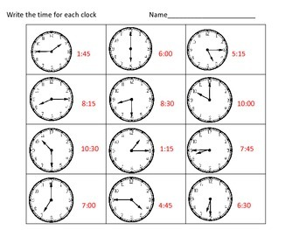

Slide 6
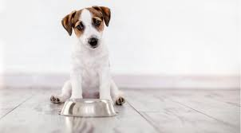
How is the dog?
The dog is
What does it want to do?
to eat corn.
hungry
It wants

Slide 7
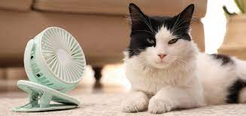
How is the cat?
The cat is hot.
What does it want to do?
to have cold milk.
It wants

Slide 8
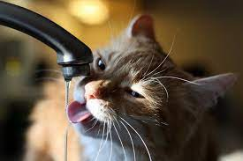
How is the cat?
The cat is thirsty.
What does it want to do?
It wants to drink water.

Slide 9
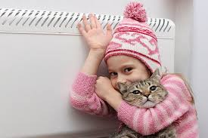
How are they?
They are cold.
What do they want to do?
to have hot tea.
They want

Slide 10
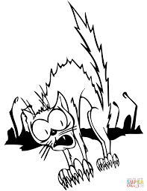
How is the cat?
The cat is frightened.
What does it want to do?
It wants to go home.

Slide 11
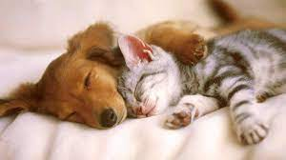
How are they?
They are tired.
What do they want to do?
They want to sleep.

